Slide 1
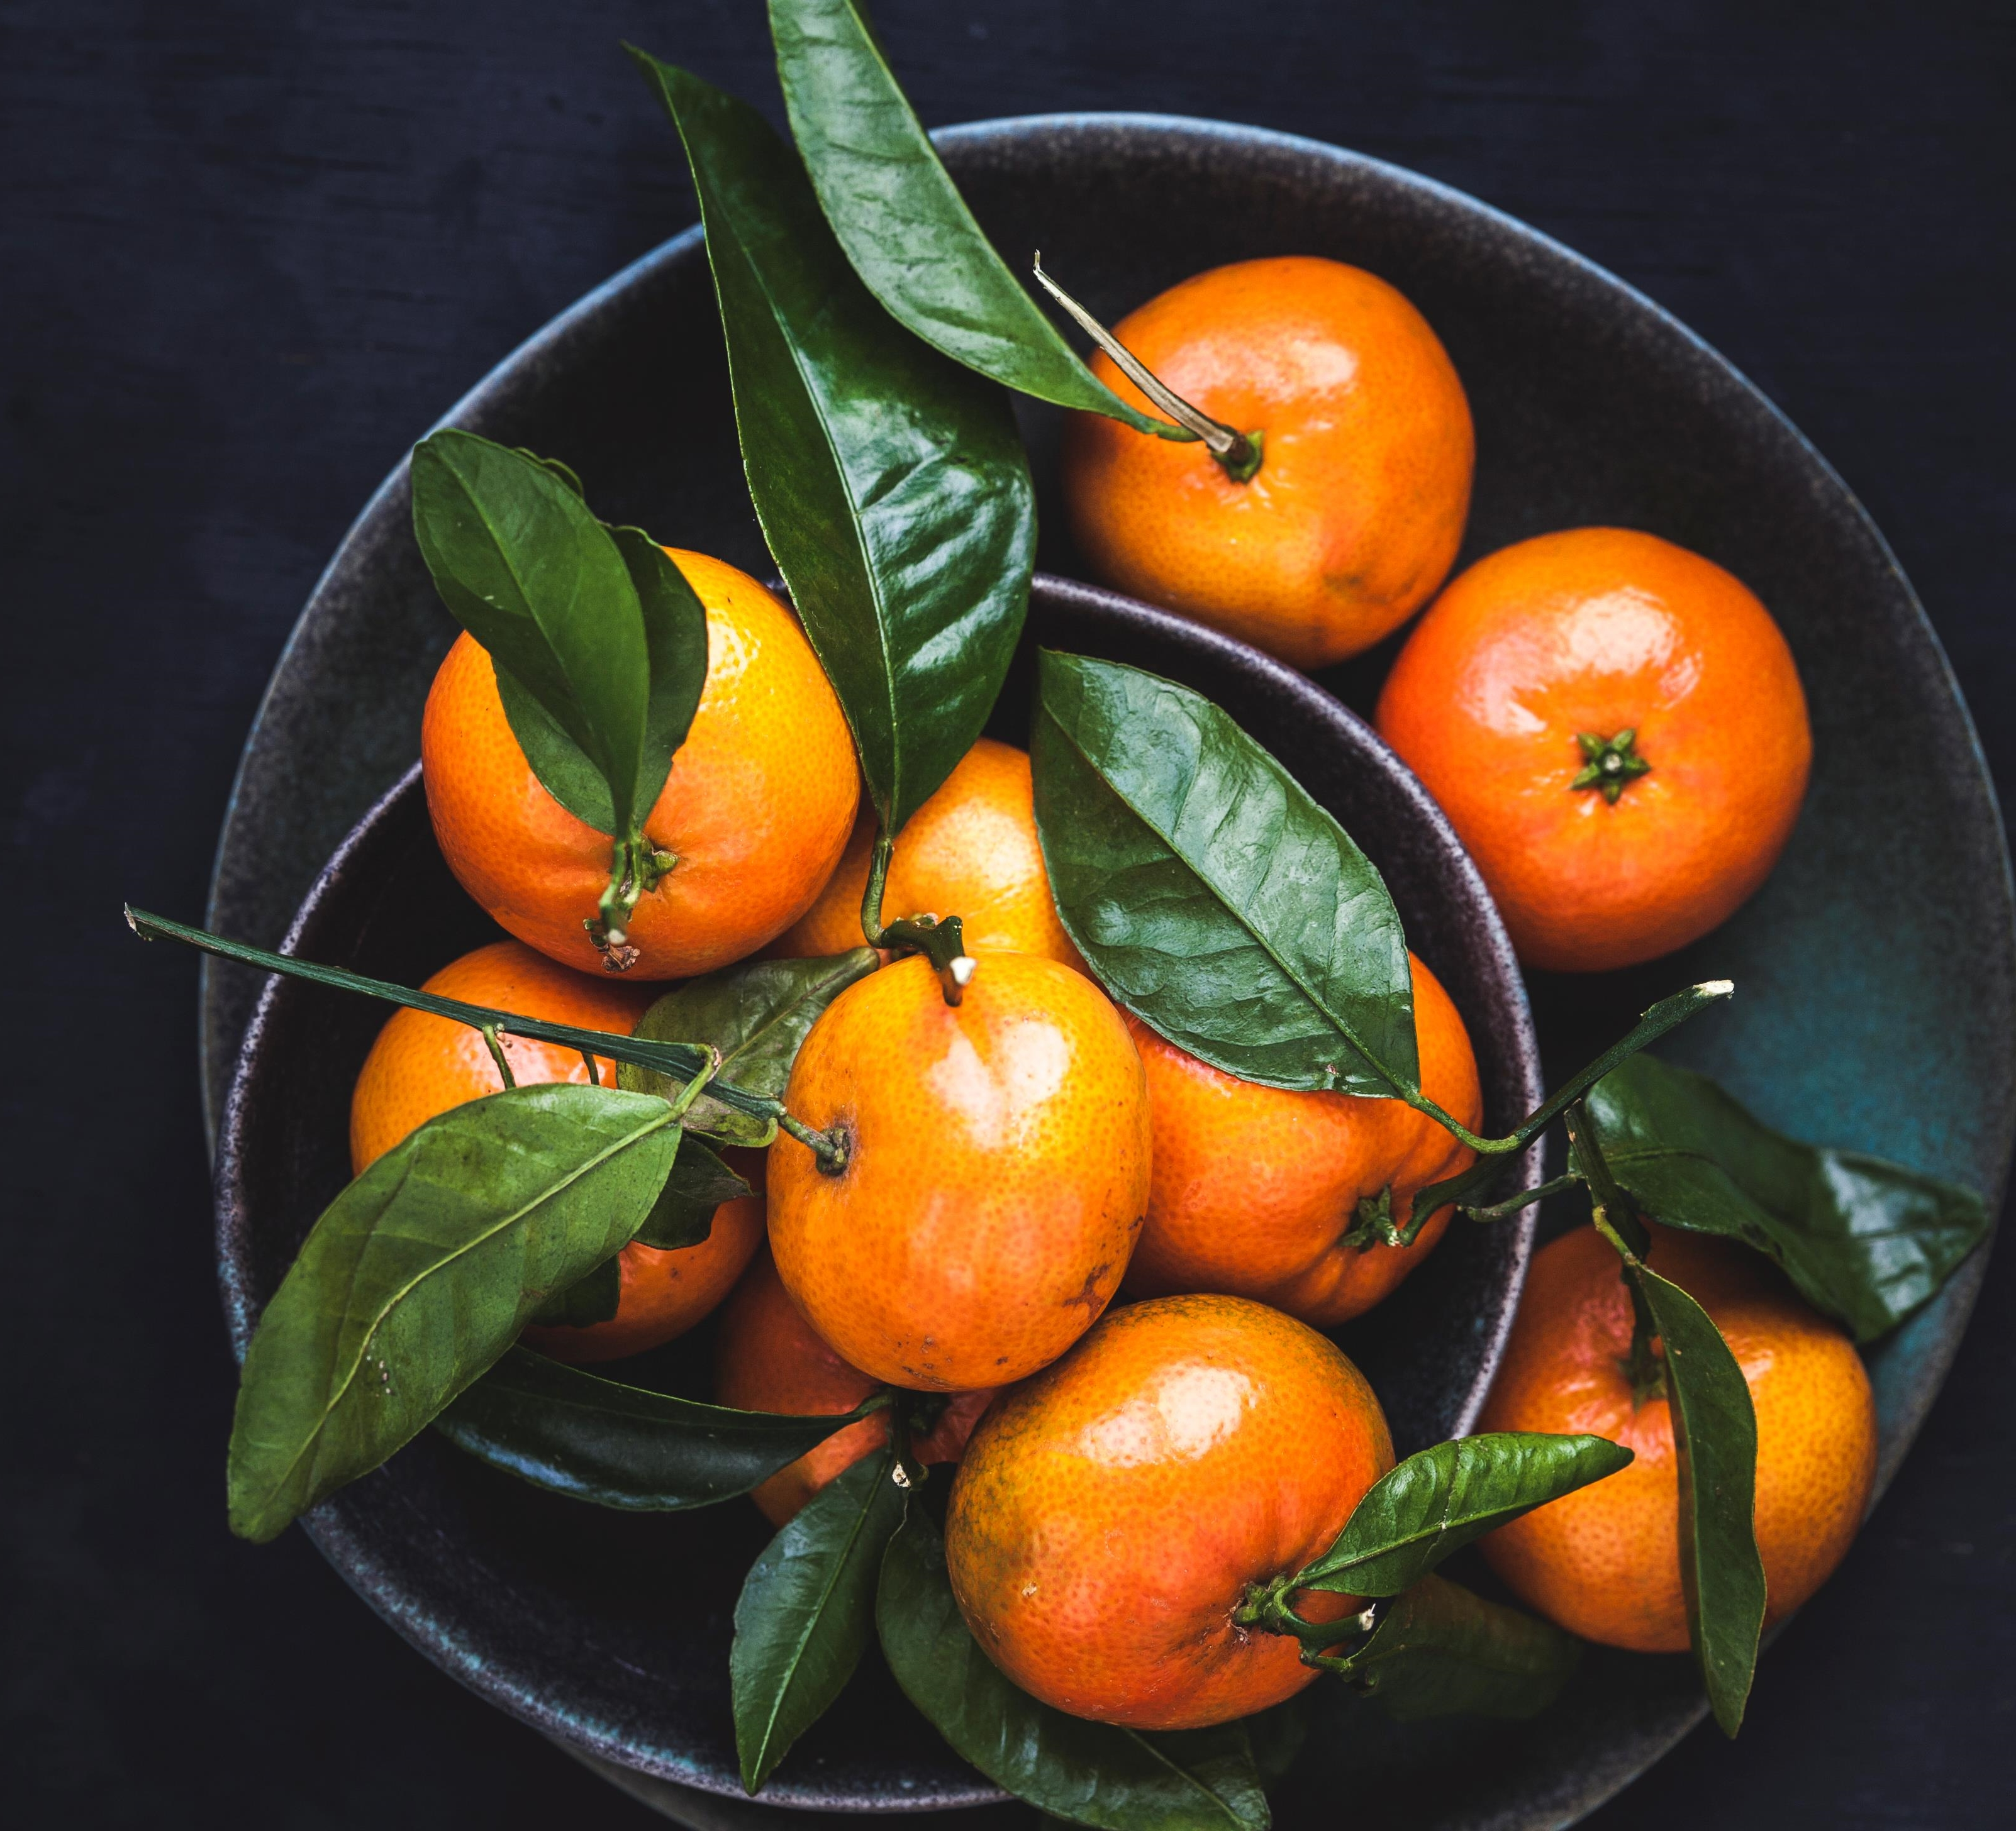
Simple app. Amazing recipes.

Slide 2

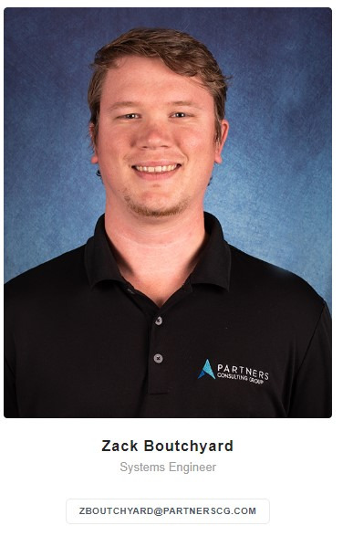
Welcome!
I am Zack Boutchyard
I am here to show you a minimalistic, modern solution that will provide instructions on how to make the most delicious meals.

Slide 3

Zesta
-A refined experience-

Slide 4
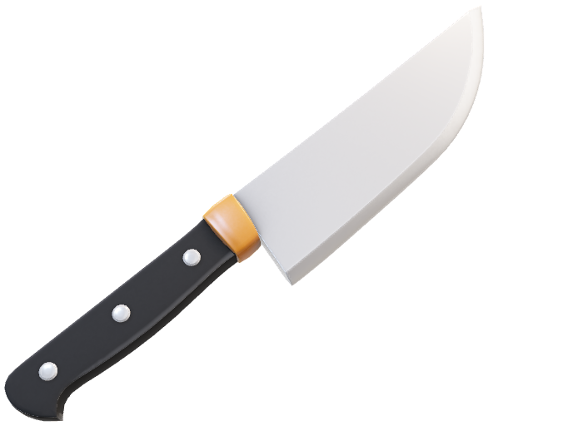
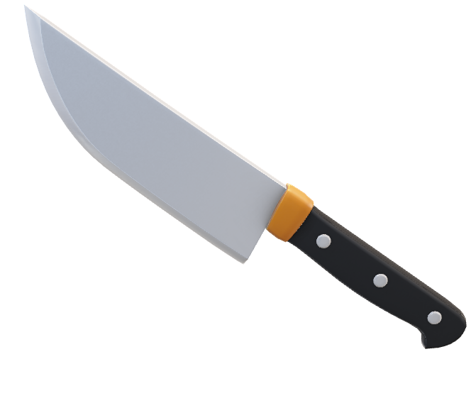
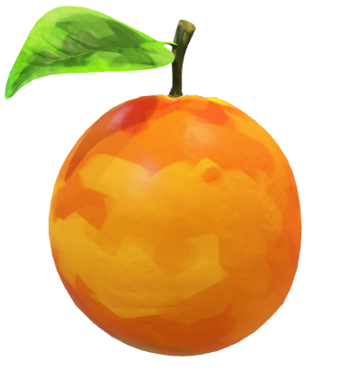

Slide 5
Purpose:
Minimalistic
Inviting
Exclusive set of recipes (The focus isn’t on the number of recipes, but the quality of the recipes provided)

Slide 6
Audience:
This app caters towards the users that are wanting to develop better cooking skills and want to learn the fundamentals of cooking through a carefully selected list of recipes.

Slide 7
Features:
Intuitive design aimed to make a stress-free experience when looking for meals.
Exclusive recipes shown on a small list
Pictures and examples of how the meal should look at the end of the recipe
Recommendation of a side and a link to that page.

Slide 8
competition
There are several apps that provide recipes. My job is to set ourselves apart from the competition.
Yummly (Largest, has 2M users. Lots to choose from, this app will provide a simplistic design setting ourselves apart.)
Tasty (This app has large descriptions and a story on most recipes, my app will have the recipes and the recipes only)
NYT Cooking (has recipes from anyone who wants to add them. My app will have pre-selected recipes that will ensure perfection of the amount and ingredients listed)

Slide 9
RISKS/weaknesses
Over-Simplistic (not enough features)
Not allowed to add recipes (people may want to go to an app that they can share their own recipes)
Not enough recipes (They may be looking to cook something different)

Slide 10
Development Process
Concept
(1-3 days)
Design/Develop
(2-3 weeks)
Test/Release
(1-3 days)

Slide 11
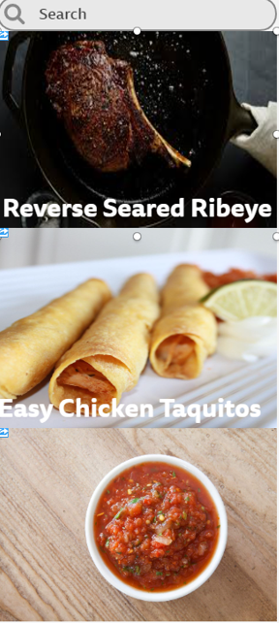
Example
No Messy explanations here, just easy
recipes with big, nice pictures to click on.

Slide 12
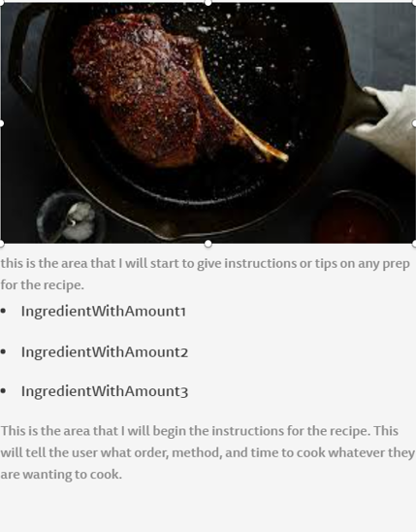
Example
I plan on making the recipes as short and sweet as possible to minimize the amount of re-reads the user has to do to find their place again.

Slide 13
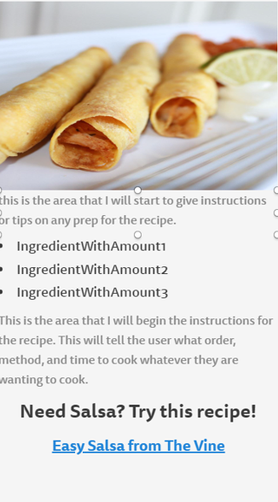
example
In Recipes like this, I plan on having a link embedded for the user to easily navigate to another recipe they would possibly use as a side to go with the dish.

Slide 14
Thank you!
Any Questions?
E-mail me at zacbou5063@students.ecpi.edu

